Slide 1

DEPARTMENT OF COMPUTER SCINENCE – ARTIFICIAL INTELLIGENCE
Persistent Key-Value Storage Engine
Presented By:
Name | USN | Roll No.
Pooja D | 01FE24BCI105 | 232
Sukanya S | 01FE24BCI108 | 235
Keerthana K | 01FE24BCI118 | 242
Sakshi D Suryavanshi | 01FE24BCI109 | 236
Under the Guidance of :
Prof. Shrushti Gani

Slide 2
Persistent Key-Value Storage Engine
Proposed Engine Summary
Engine ID | Proposed Engine Name | Major course Covered | Technical Problem Owned | Primary Responsibility | Primary Student Owner
E1 | Parsing Engine | Compiler Design + Data Structures + DBMS | Understanding and validating commands entered using the custom NoSQL command language | Perform lexical analysis, syntax checking and semantic validation, and convert commands into structured instructions | Pooja K D
E2 | Storage Engine | Operating Systems | Permanent storage and modification of key-value records | Create, update, delete and persist key-value records in local storage | Sakshi D Suryavanshi

Slide 3
Persistent Key-Value Storage Engine
Engine ID | Proposed Engine Name | Major course Covered | Technical Problem Owned | Primary Responsibility | Primary Student Owner
E3 | Retrieving Engine | Data Structures + DAA | Efficiently finding a value using its key | Efficiently finding and returning the value associated with a key | Sukanya M S
E4 | Indexing Engine | Data Structures + DAA | Slow key lookup as the number of records increases | Maintain a key-to-storage-location mapping for faster lookup and retrieval | Keerthana K

Slide 4
Persistent Key-Value Storage Engine
DEPARTMENT OF COMPUTER SCINENCE – ARTIFICIAL INTELLIGENCE
Courses | Concepts Used
DAA (Design and Analysis of Algorithms) | Hashing and efficient searching
Data Structures | Hash tables, key-value pairs and indexing
Operating Systems | File handling, file operations and data persistence
Compiler Design | Lexical analysis, syntax checking and semantic validation
DBMS | Database operations, record management and data recovery

Slide 5
Persistent Key-Value Storage Engine
Functional Requirements
FR ID | Description
FR-01 | The system shall accept and validate custom NoSQL commands using the Parsing Engine.
FR-02 | The system shall create, update, and delete key-value pairs using SET, UPDATE, and DELETE commands.
FR-03 | The system shall retrieve values associated with keys using the GET command.
FR-04 | The system shall maintain an index mapping keys to storage locations for faster retrieval.

Slide 6
Persistent Key-Value Storage Engine
FR ID | Description
FR-05 | The system shall permanently store key-value records in local storage.
FR-06 | The system shall recover stored data and rebuild the index when the application restarts.
FR-07 | The system shall detect invalid commands and display appropriate error messages
FR-08 | The system shall report an error when a requested key does not exist.
FR-09 | The system shall provide a web interface for performing database operations and viewing results.
FR-10 | The system shall identify and remove obsolete records through compaction to improve storage efficiency.

Slide 7
Persistent Key-Value Storage Engine
DEPARTMENT OF COMPUTER SCINENCE – ARTIFICIAL INTELLIGENCE
Functional Requirement | Engine Used
FR-01: Accept and validate NoSQL commands | Parsing Engine
FR-02: Create, update and delete key-value pairs | Storage Engine
FR-03: Retrieve values using the GET command | Retrieving Engine, Indexing Engine
FR-04: Maintain an index for faster retrieval | Indexing Engine
FR-05: Permanently store records in local storage | Storage Engine
FR-06: Recover data and rebuild the index after restart | Storage Engine, Indexing Engine
FR-07: Detect invalid commands and display errors | Parsing Engine
FR-08: Display an error when a key does not exist | Retrieving Engine
FR-09: Remove obsolete records through compaction | Storage Engine

Slide 8
Persistent Key-Value Storage Engine
Non-Functional Requirements
NFR ID | Description
NFR-01 | The system shall respond to standard database operations within 2 seconds under normal workload.
NFR-02 | The system shall retrieve a key-value record within 1 second for a database containing up to 10,000 records
NFR-03 | The system shall support at least 10 concurrent user requests without crashing.

Slide 9
Persistent Key-Value Storage Engine
NFR-04 | The system shall recover stored data and rebuild the index within 10 seconds for up to 10,000 records.
NFR-05 | The system shall support at least 10,000 key-value records without requiring changes to the application architecture.

Slide 10
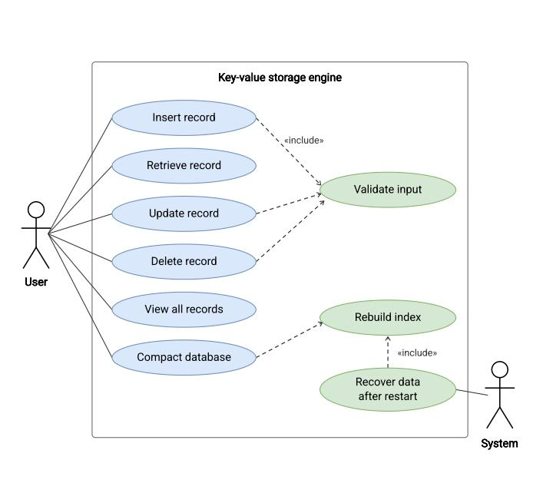
Persistent Key-Value Storage Engine
Use Case Diagram
The diagram shows how the user performs operations such as inserting, retrieving, updating, deleting, viewing records, and compacting the database.
It also shows input validation, index rebuilding, and data recovery after restart to maintain correct and consistent storage.

Slide 11
Persistent Key-Value Storage Engine
DEPARTMENT OF COMPUTER SCINENCE – ARTIFICIAL INTELLIGENCE
Thank You

